Slide 1

Introducing Hjezle: Transforming Sports Field Booking
From chaotic calls and missed bookings to smooth, instant reservations with zero frustration.

Slide 2
Booking Nightmares Before Hjezle
Common Issues
Result
Random calls, no answers
Stress, confusion, missed matches
Confusing messy notes
Last-minute changes
Player cancellations

Slide 3
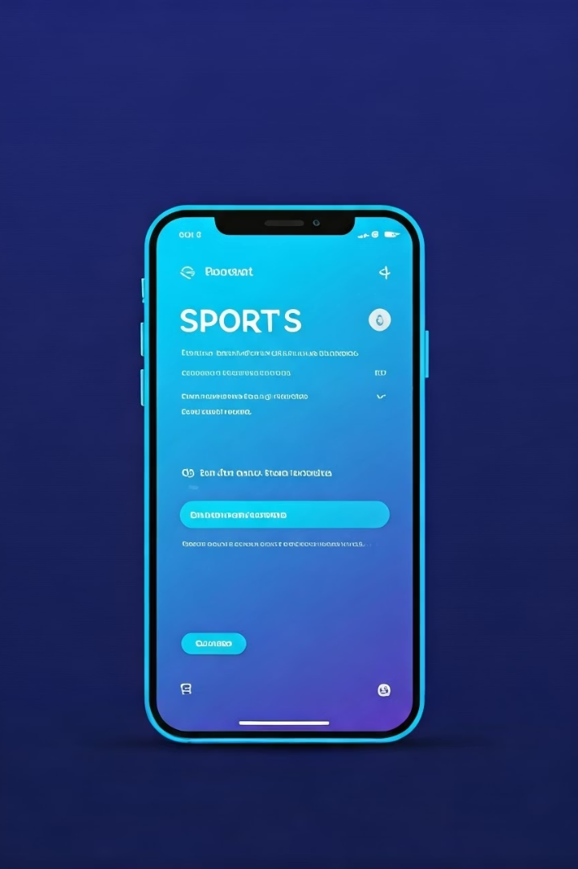
Hjezle Solves Real Player Problems
Booking struggles
Last-minute surprises
Payment confusion

Slide 4

How Hjezle Works: Simple and Instant
1
Open app
2
Filter by sport and time
3
Select free field instantly
4
Tap, pay securely, confirm booking

Slide 5
Group Bookings Made Easy
Invite team members
Real-time updates
Manage bookings and communications
No calls or guesswork necessary

Slide 6
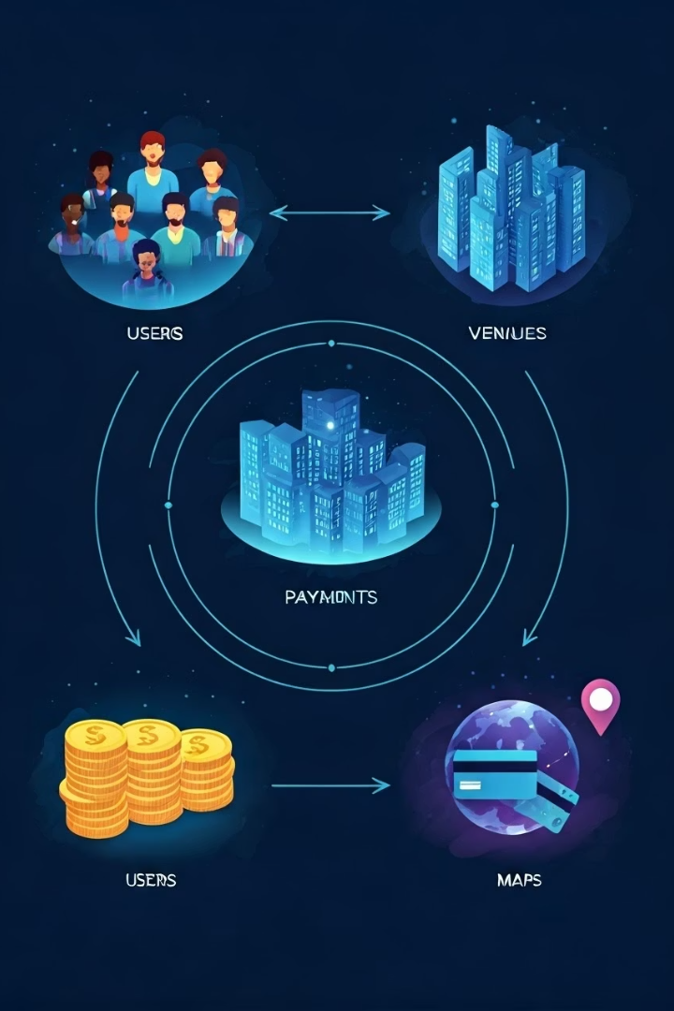
Robust System Modeling Behind the Scenes
1
Context Models
Users, venue owners, payment systems
2
Interaction Models
User step-by-step actions
3
Structural Models
Linking users, venues, and bookings
4
Behavioral Models
Handling cancellations, failures, changes

Slide 7

Technology Stack Powering Hjezle
Flutter & FlutterFlow
Firebase
Fast, beautiful UI with rapid development
Real-time data sync and secure authentication
Google Maps API
Accurate location search & field mapping

Slide 8
Meeting Rigorous Requirements and Challenges
Functional Needs
Key Challenges
Fast registration
Real-time updates
Secure bookings & payments
Payment security
Notifications and profiles
Overcoming these strengthened Hjezle

Slide 9

Our Vision and Future Roadmap
Frictionless Booking
Lebanon’s Biggest Sports Community
Middle East Expansion
Future Features
Smart venue recommendations
Loyalty rewards
Tournament management

Slide 10

Building a Sports Movement with Hjezle
More than bookings – creating a connected, empowered sports community for lasting impact and growth.

